Slide 1
Stopwatch Using Keyboard Input, Timer & LCD Display
Namrata Raj, Aarohi Jadav, Mrunal Kulkarni, Venkatesh Gaur, Prakhar Arya

Slide 2
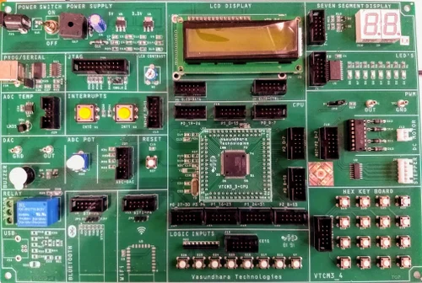
Introduction
The project uses LPC1768 Microcontroller from NXP Semiconductors to create a digital stopwatch using embedded C programming and using the microcontroller inbuilt timers

Slide 3
Apparatus Used
NXP LPC1768 Development Board
ALS-SDA-ARMCTXM3-01
Power Supply(+5V)
Cross Cable
10 Core FRC Cables
USB to B Type
Connections
CND to CNAD (P0.23-P0.28)
CNB to CNB3 (P2.10-P2.13)
Software
Keil
Flash Magic

Slide 4
Main Function
SystemInit() - Essential initialization required for Microcontrollers to operate correctly. Enables or disables clocking various peripherals on the chip. (Clockgating)
SystemCoreClockUpdate() - This function is responsible for calculating and updates SystemCoreClockUpdate. Also calls the lcd_init() and stopwatch function to start the stopwatch functionality

Slide 5
Initialization
Sets up display parameters and prepares it for use within the program
LPC_PINCON->PINSEL1 : refers to a register that controls the pin select function for port 1
Bitwise & operation with 0xFC003FF ensures the pins from P0.23 to P0.28 are set at GPIO pins
LPC_GPIO0-> FIODIR - refers to data direction for port 0.

Slide 6
Initialization
The bitwise | operation with 0x0F <<23 | 1 << 27 | 1 << 28 ensures that the pins P0.23-P0.28 are set
delay(3200) functions introduces a delay of 3200 microseconds. It’s required by the LCD to power up and stabilize
The LCD initialization sequence begins with setting display mode and font size commands, followed by delays to ensure proper execution. Subsequent commands configure cursor movement and turn on the display with invisible cursor through the two parameter function input lcd_comdata(0x32, 0)
The lcd_init() function configures the necessary pins, sends initialization commands to the LCD, and prepares it to display messages

Slide 7
Stopwatch Functionality
Responsible for controlling stopwatch functionality
Within the stopwatch function, there is a loop that continuously scans for keypresses. These keypresses determine the actions to be taken, such as starting, stopping, or resetting the stopwatch.
Once the stopwatch is started, the elapsed time is displayed on the LCD display. This display is continuously updated to reflect the current elapsed time. The stopwatch function is responsible for timing the duration of the stopwatch. It updates the display with the elapsed time, ensuring that users can see the current stopwatch reading in real-time

Slide 8
LCD Control Functions
LCD_comdata() : This function is responsible for sending the data the the LCD display.
Consists of two parameters : temp1: contains the date to be sent and type: specifies if it is a command or data when type value is 0 it is a command and when it’s 1 it’s data

Slide 9
Key Scanning
Plays a crucial role in scanning keypad input
The fourth that is the last row of the 4x4 keyboard is made enabled and through this it is decided that the user has pressed key corresponding to which column
If a key is indeed pressed, the function extracts the necessary bits to identify which key was pressed, storing this information in the “key” variable for further processing.

Slide 10
Delay Function
In this function the input parameter is milliseconds (unsigned int) and the timer used is TIMER0.
When the function is called, the TCR is first reset, then enabled.
After that it waits till the timer counter reaches the desired delay. Then TCR is disabled.

Slide 11
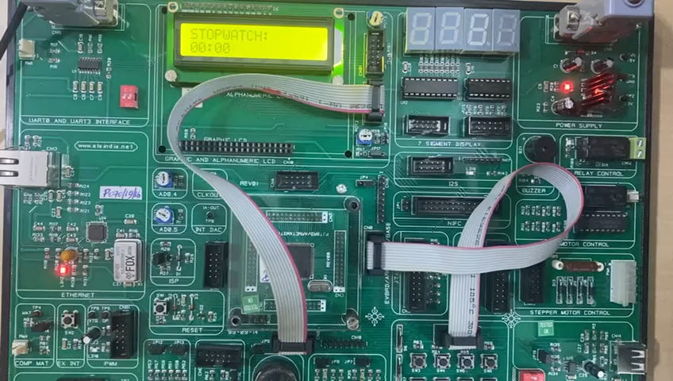
Demonstration

Slide 12
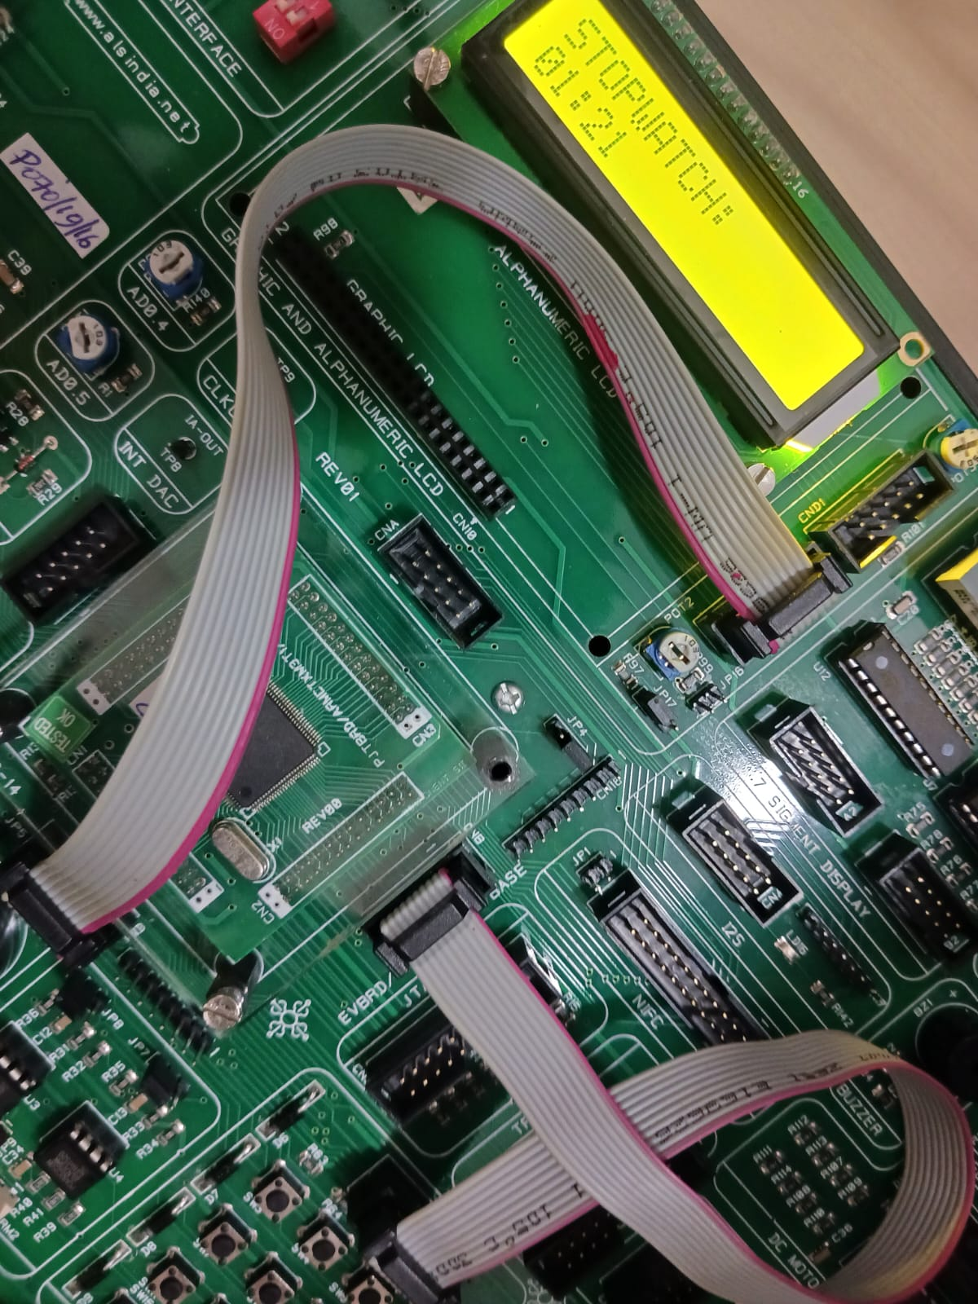
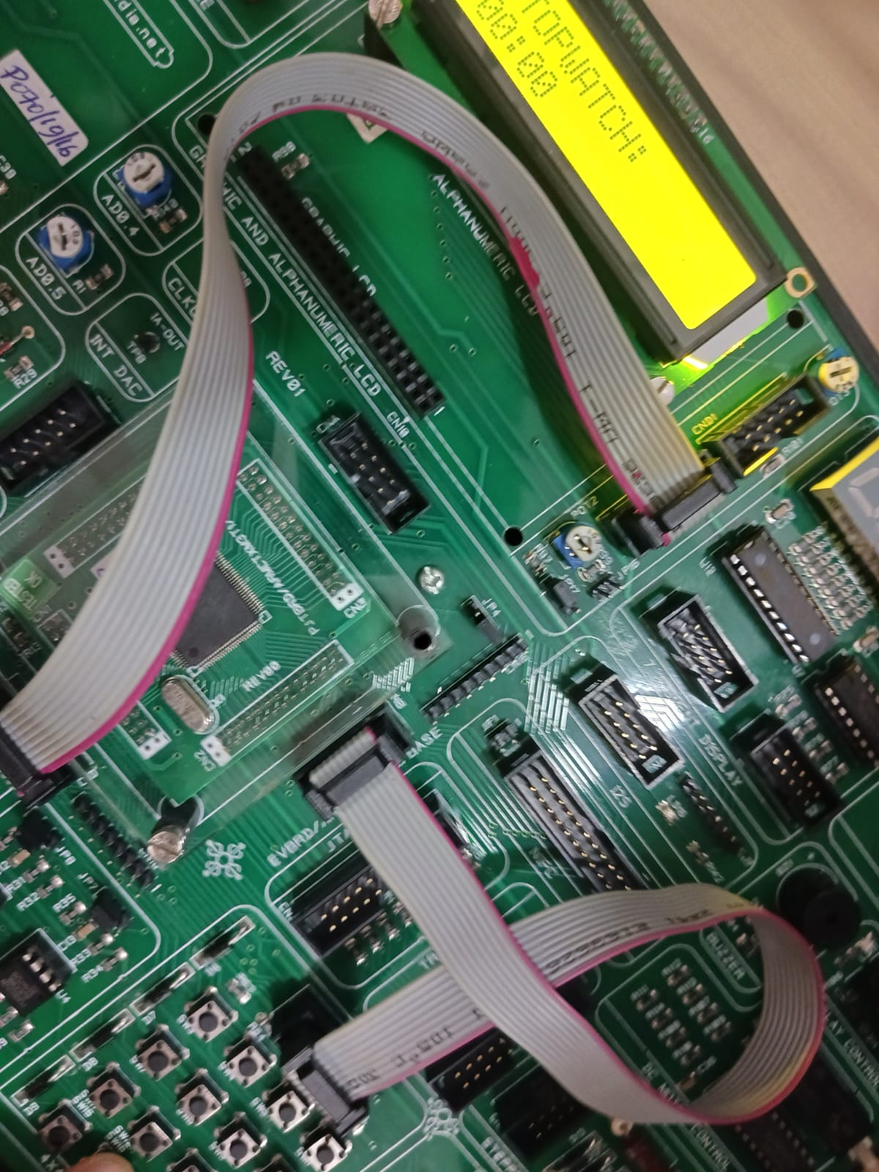
Demonstration

Slide 13
Conclusion
In conclusion, the "Stopwatch Using Keyboard Input, Timer, and LCD Display" project achieves its objectives of creating a user-friendly time-tracking system with precise measurement and clear visual feedback.
Overall, the project serves as a valuable learning experience in embedded systems development, showcasing the team's skills in hardware-software integration and engineering.

Slide 14
References
Muhammad Ali Mazidi, Sarmad Naimi, Sepehr Naimi, Janice Mazidi - ARM Assembly Language_ Programming and Architecture (2013)
The Intel Microprocessors by Barry Brey,4th edition.
Embedded_Systems_Introduction_to_Arm_Cor.

